Slide 1


SAP S/4HANA CDS, SAC Training Day 6
Anubhav Oberoy

Slide 2

Agenda – Day 6
CDS Table functions
CDS Hierarchy
New Hierarchy
Classic Hierarchy
Introduction to BOPF
Notes:
https://unsplash.com/photos/CPs2X8JYmS8

Slide 3



















Slide 4
Can we call an AMDP from CDS view?
Can we integrate cds using AMDP?
Is it possible that CDS view can contain SQL script code.
We are working on project and there are some limitations we are facing with cds views, what is the option we have.
I want to use HANA native functions in CDS, how to use them?
CDS Table function
It is just like AMDP but can only used for read-only scenario
First we will create a cds table function, which define the skeleton of the data.
Then create a implementation method like AMDP where we can write SQL Script code.
A table function can be integrated with other cds views using joins or association
You can call another amdp/table function.
Overcome limitations of cds views, we can use hana specific functions
It is also one of the best way to achieve code to data.

Slide 5
Can I debug AMDP
https://www.youtube.com/watch?v=fpXoTqHLeSo&pp=ygUKZGVidWcgYW1kcA%3D%3D
How to analyze performance of AMDP
https://www.youtube.com/watch?v=KLgTI1J5d3E&pp=ygUccGVyZm9ybWFuY2UgYW5hbHlzaXMgb2YgYW1kcA%3D%3D
Can we call one AMDP inside another
https://www.youtube.com/watch?v=r2LsDROiJ90&pp=ygUccGVyZm9ybWFuY2UgYW5hbHlzaXMgb2YgYW1kcA%3D%3D
Can you show a real-time use case of AMDP
https://www.youtube.com/watch?v=Tm1RFOt0KMY&pp=ygUccGVyZm9ybWFuY2UgYW5hbHlzaXMgb2YgYW1kcA%3D%3D
How to do FOR ALL ENTRIES (abap) using AMDP
https://www.youtube.com/watch?v=dIMPMNlT7jQ&pp=ygUccGVyZm9ybWFuY2UgYW5hbHlzaXMgb2YgYW1kcA%3D%3D
How to pass select options to an AMDP
https://www.youtube.com/watch?v=hbtnWi032Z8&pp=ygUTc2VsZWN0IG9wdGlvbnMgYW1kcA%3D%3D

Slide 6
































Slide 7




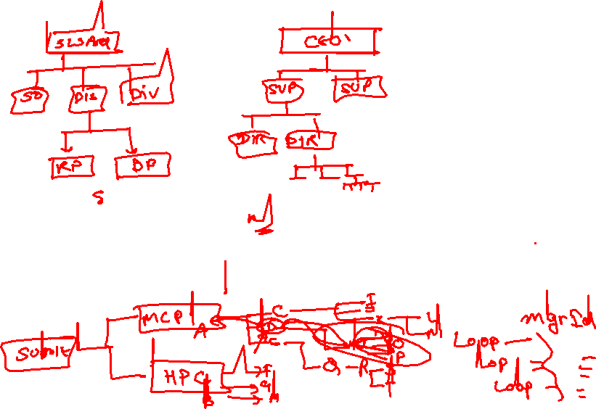









CDS hierarchy
Hierarchy is a tree data structure, it is one the best way to represent the business data in more readable way. It gives a visualization in form of tree to showcase dependencies better.
CDS views are the most important data models to expose data from our system. If we have data which can be related in tree structure, we can use cds hieararchy. The main advantage would be that we traverse data faster.
I have employee manager table, I have relation between employee and manager which multilevel. I have been asked to develop a report where input will be manager id, output will be all the sub-managers, their managers… and their reportees.
www.anubhavtrainings.com

Slide 8
Node js 18 - Windows 64-bit Installer: https://nodejs.org/dist/v18.12.0/node-v18.12.0-x64.msi
VS Code - https://code.visualstudio.com/download
Fiori Tool Extension pack

Slide 9













Title
@EndUserText.label : 'ZOFT_EMP_MGR'
@AbapCatalog.enhancement.category : #NOT_CLASSIFIED
@AbapCatalog.tableCategory : #TRANSPARENT
@AbapCatalog.deliveryClass : #A
@AbapCatalog.dataMaintenance : #ALLOWED
define table zoft_emp_mgr {
key mandt : mandt not null;
key empid : pernr_d not null;
key empname : char100 not null;
managerid : pernr_d;
costcenter : kostl;
}
www.anubhavtrainings.com

Slide 10










































Slide 11
CDS-BOPF Integration
Can I update data using CDS views also.
Anubhav SAPGUI have locking concept while data updates, can we also do it while building app from Fiori
What is BOPF, my manager asked me to learn CDS and BOPF for next project
What is Fiori programming model for S/4HANA
How can we overcome disadvantages of GUI applications?
Why did SAP choose still ABAP as middleware for S/4HANA Solution?
fiori
Scaling of app due to session stickiness
Bad user experience
Device switch (draft)
Collaboration
Performance
Support of oData
Adapt SAP Fiori
Device switch (draft)
Collaboration
Performance
pre
odata
app
app
100GB
100GB
Investments done by partners and customers
BAPIs, LUWs
Reports, Includes,
Programs, Classes
Workflows, Scripts, SF
SPRO, Webdypro
BOPF – since 2009 in SAP, Business Object processing framework
db
hana
www.anubhavtrainings.com

Slide 12

BOPF
Stands for Business Object processing framework, which generates most of application code to create, update, delete, lock, unlock, modify, patch data based on a business object (data model).
Now we can create
CDS views with association
Code
Business Object (fuel)
BOPF
www.anubhavtrainings.com

Slide 13
Scenario
We are working in an airline company inside S/4HANA project. They have a challenge due to pandemic to deliver the meal to departing flights from airport. The supervisor along with flight crew has to plan the meal which will be on-boarded in the flight.
The staff would use a tablet most of time to check status of on-going flights and number of seats in that flight.
We want to develop solution which can help us creating new flight entry
Change meal assignment of a particular flight
Also take approval from food manager for the assigned meal
@EndUserText.label : 'Flight Meals'
@AbapCatalog.enhancement.category : #NOT_CLASSIFIED
@AbapCatalog.tableCategory : #TRANSPARENT
@AbapCatalog.deliveryClass : #A
@AbapCatalog.dataMaintenance : #ALLOWED
define table zoft_meals {
key mandt : mandt not null;
key meal_id : /bobf/uuid not null;
carrid : s_carr_id;
connid : s_conn_id;
meal : s_mealnum;
total_seats : s_seatsmax;
status : flag;
}
SO
SO_I
www.anubhavtrainings.com

Slide 14
Title
Fiori UI
OData
BOPF
class
HANADB
https://www.youtube.com/watch?v=C9MWowuCxis&list=PLcxqFaocb9WLtnq-rpXbRy5hnKECxr95G&index=88
www.anubhavtrainings.com

Slide 15

Title
Text

Slide 16
Title
Text

Slide 17

Questions?

Slide 18

Thank you
Anubhav.abap@gmail.com
contact@anubhavtrainings.com
+91 84484 54549
www.anubhavtrainings.com

